Slide 1
ERVET Emilia-Romagna Valorizzazione Economica Territorio SOCIAL INNOVATION
28/06/2017
Elisa Bottazzi
European Union, International Cooperation and Social Inclusion Unit

Slide 2
ERVET
ERVET operates as an in-house providing agency for the Emilia-Romagna Region on a not-for-profit basis supporting the sustainable development and the environmental improvement of the regional territory.
ATTRACTIVENESS AND COMPETITIVENESS OF ECONOMIC SYSTEMS
EUROPEAN UNION, TERRITORIAL COOPERATION AND DECENTRALISED COOPERATION
EU STRUCTURAL FUND
SUSTAINABLE DEVELOPMENT
TERRITORIAL DEVELOPMENT
KNOWLEDGE SOCIETY, WELFARE AND EMPLOYMENT

Slide 3
ERVET SECTORS OF SOCIAL INNOVATION
MIGRATION
EMILIA-ROMAGNA DIGITAL AGENDA
SOLIDARITY ECONOMY
SOCIAL ECONOMY
CULTURE & CREATIVITY

Slide 4
SOCIAL ECONOMY DEFINITION
Key principles
socio-economic actors which do not simply look for mere profit but their actions are motivated by principles such as reciprocity and democracy NOT FOR PROFIT
democratic participation of members
production of good and services between “the economy for profit” and “public economy” THIRD SECTOR ORGANISATIONS
mitigating distortions generated by the market SOCIAL VALUE
SE represents 10% of all European businesses, with 2 million undertakings or 6% of total employment (more stable than European average), active population involved in Social Enterprises is 4.1% in Belgium-7.5% in Finland -3.1% in France - 3.3% in Italy and 5.7% in UK. (CIRIEC)

Slide 5
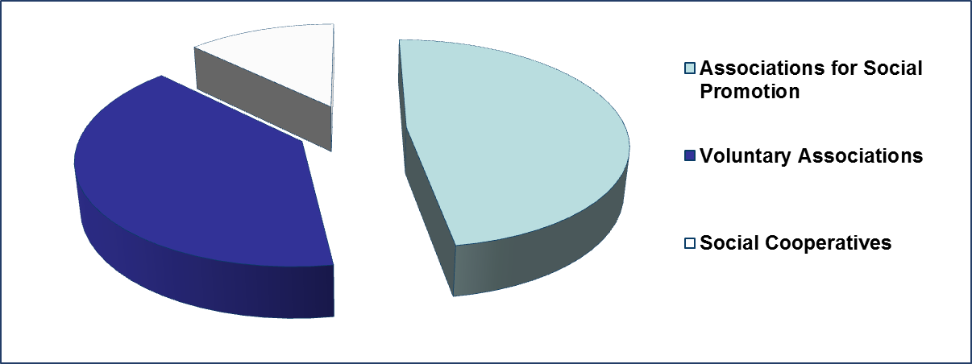
SOCIAL ECONOMY IN EMILIA-ROMAGNA REGION
3600 Associations for Social Promotion oriented towards ricreative activities, culture and sport.
3000 Voluntary Associations. Their activities are focused in particular on health, social assistance and civil protection.
970 Social Cooperatives have a turnover of around 2 billion euros employing approximately 43 thousand employees. Social cooperation plays a major role with regard to the provision of services, in partnership with the Public Administration.

Slide 6
SOCIAL ECONOMY Ervet activities
Emilia Romagna Region has recognized social economy and social innovation as key drivers for the strengthening of the territories resilience and development and in 2007 created a Social Economy Working Group to foster and support social innovation experiences promoted by local communities and Regional stakeholders.
Actors involved:
Regional Social Policies Service
Regional Third Sector stakeholders (Regional Cooperatives, Third Sector Forum)
Other Regional departments: Planning and Evaluation Service, European Policies and International Relations Service
ERVET - Regional Development Agency

Slide 7
SOCIAL ECONOMY
Ervet activities
Researches
2011
“A new approach to welfare: generative experiences” to promote the development of a new welfare model, starting from the contribution of the Third sector, which represents an added value in terms of design and production of services intended to feed the community welfare
2014
“Welfare and (Well)being: the role of enterprises in the development of the Community” to enhance the contribution of for profit companies in the creation of welfare services

Slide 8
SOCIAL ECONOMY Ervet activities Guidelines for co-design of social services
Co-design represents a new opportunity to innovate welfare policies through a partenrship between PA and civil society, able to create a more efficient governance and implementation of social services. Facing emergents needs, co-design is going to become an appropriate measure in the strengtheningb of shared values and integration of internal and external resources.
In 2016 the Welfare Department of Emilia Romagna Region has developed an intensive research activity of welfare main topics, focusing especially on innovative phenomena with the aim to highlight the virtuos experiments on its territory.

Slide 9
SOCIAL ECONOMY
Ervet activities
International networking & partnership
AGORADA CONFERENCE : SOCIAL INNOVATION FOR TERRITORIES
(Bologna, 22-23 November 2016) gathered local authorities, local development agencies, universities, social enterprises, cooperatives, SMEs from different EU countries
INTERNATIONAL GROUP ON SOCIAL INNOVATION (IGSI): an interconnected network of Development Agencies, Public Administrations and stakeholders committed with Social Innovation
SHARED VALUE AND SOCIAL CORPORATE RESPONSIBILINEW SPACES,
PLAYERS AND TECHNOLOGIES FOR SOCIAL INNOVATION: urban revitalization, active citizenship, social start-up, digital artisans, co-working, sharing economy, dynamics or digital technology within urban contexts, etc.
FINANCE FOR SOCIAL INNOVATION: impact measurements, new patterns for social investment, social funds and bonds, microfinance, crowdfunding and social lending, etc.
PUBLIC PROCUREMENT FOR A NEW WELFARE: new rules in public procurement new role of PA and switching to a new approach and tools

Slide 10
“Social enterprises are drivers of social change”
SOCIAL ECONOMY
Ervet activities
International projects
INTERREG EUROPE Project
RaiSE - Enhancing social enterprises competitiveness through improved business support policies
Partners: 7 partners from Spain, Italy, Hungary, Austria, UK, Ireland, Sweden
Main objectives:
contribute to competiveness of SE in EU through improved regional policy development, enabling specialized business assistance and support.
promoting growth and access to market, thereby targeting relatively consolidated SE
Include news tools for supporting SE within European Social Fund
Regional Stakeholder group: Managing Authority ESF and ERDF, DG Social Policy, Third Sector Forum, Central cooperatives, Chambers of commerce, ERVET, ASTER

Slide 11
“Social enterprises are drivers of social change”
SOLIDARITY
ECONOMY
Ervet activities
Supporting the implementation of Regional Law 19/2014 promoting solidarity economy
Social model based on: ethic justice, equity, social cohesion, environmental preservation, territorial based approach, social, economic and civic development of communities
Regional Working Group
Regional Forum of Solidarity Economy gathering all relevant stakeholders
Observatory of Solidarity Economy: monitoring and analysis of the activities promoting and supporting Solidarity Economy

Slide 12
MIGRATION ERVET activities Social inclusion and integration of Third Countries nationals
Supporting Emilia-Romagna Region in the management and implementation of EU projects financed by AMIF – Asylum Migration and Integration Fund aimed at fostering social inclusion and integration of Citizens from Third Countries:
ITALIAN LANGUAGE COURSES
SUPPORTING ACCESS and INTEGRATION INTO THE WELFARE SISYTEM (health-care services, home inclusion, social services)
VOCATIONAL TRAINING & LABOUR INTEGRATION
SCHOOL INTEGRATION
SUPPORTING CIVIC & ECONOMIC PARTICIPATION
ANTIDISCRIMINATION
ERASMUS plus project - Digital Generation Gap in Migrant and Low educated Families
INTERNATIONAL AND NETWORKING activities on Migration issues (e.g. supporting Migrant Entrepreneurship)

Slide 13
Main project for the development of digital literacy and for the promotion of digital inclusion in Emilia-Romagna Region
https://www.paneeinternet.it/public/pei-en
Included in Emilia-Romagna Region Digital Agenda 2015-2020
Digital literacy training & digital cultural events
Focus on vulnerable groups such as migrants, uneployed, peoplewith disabilities
Digital facilitation service: 84 active locations, mostly public libraries, with e-facilitators
EMILIA-ROMAGNA DIGITAL AGENDA
2014-2017 Pane e Internet project

Slide 14
CULTURE & CREATIVITY ERVET activities Research Creative Desk
2014 Research “Culture& creativity: Richness for Emilia-Romagna
Social Value of C&C
Contribution of urban planning to participation, promotion of multicultural and cultural identity, social inclusion
Contribution of cultural organizations and enterprises
Creative desk: promoting the participation of cultural
organization in EU funned programmes

Slide 15
FUTURE CHALLENGES
STRENGTENING MAINSTREAMING ROLE OF SOCIAL INNOVATION IN PUBLIC POLICIES
CO-PLANNING PROCESS (PUBLIC-PRIVATE PARTNERSHIP)
STRENGTHENING AND QUALIFYING THE SCALING PROCESS
IMPROVING MANAGEMENT SKILLS OF RELEVANT STAKEHOLDERS
SOCIAL INNOVATION & AGENDA 2030

